Slide 1
Simplification of CFG
Removal of Unit Productions
-- Sakshi Surve

Slide 2
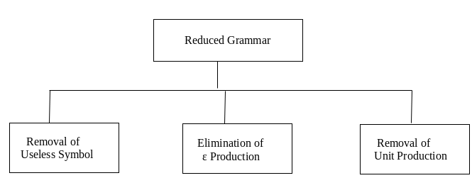
Three ways to Simplify the Grammar :

Slide 3
Removal of Unit Productions :
The unit productions are the productions in which one non-terminal gives another non-terminal. A->B
Use the following steps to remove unit production:
Step 1: To remove X → Y, add production X → a to the grammar rule whenever Y → a occurs in the grammar. [x ∈ Terminal, x can be Null]
Step 2: Now delete X → Y from the grammar.
Step 3: Repeat step 1 and step 2 until all unit productions are removed.

Slide 4
Example 1 :Remove Unit Productions S → 0A | 1B | C A → 0S | 00 B → 1 | A C → 01
Solution:
S → C is a unit production.
But while removing S → C we have to consider what C gives. So, we can add a rule to S.
S → 0A | 1B | 01
Similarly, B → A is also a unit production so we can modify it as
B → 1 | 0S | 00
Thus finally we can write CFG without unit production as
S → 0A | 1B | 01
A → 0S | 00
B → 1 | 0S | 00
C → 01

Slide 5
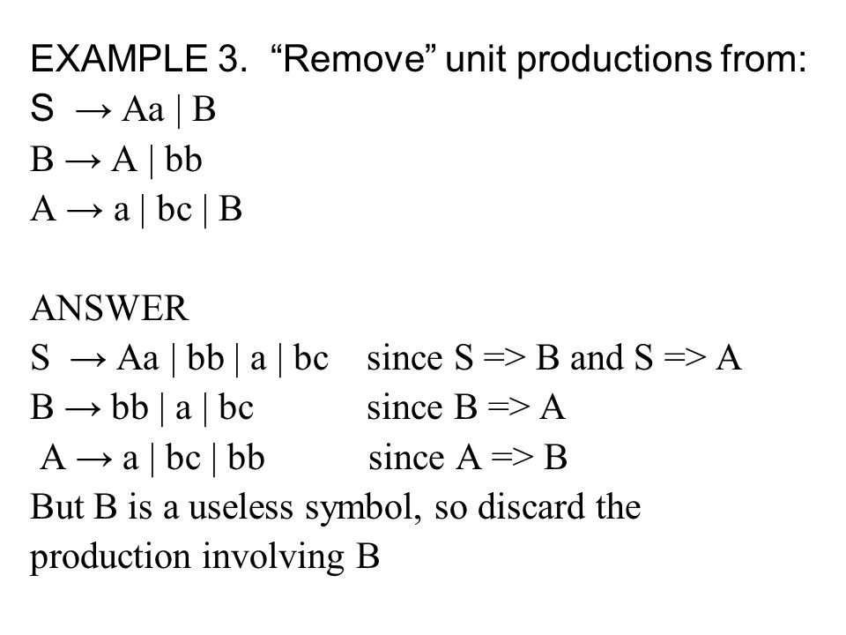

Slide 6
Example 4 : S -> Aa | B A -> b | B B -> A | a Remove Unit Productions
S -> Aa A -> b B -> a Now we find all the variables that satisfy ‘X *=> Z’. These are ‘S *=> A’ , ‘S*=>B’, ‘A *=> B’ and ‘B *=> A’. For ‘A *=> B’ , we add ‘A -> a’ because ‘B ->a’ exists in ‘G’.
Finally we get the following grammar –
S -> Aa | b | a
A -> b | a
B -> a | b
Now remove B -> a|b , since it doesnt occur in the production ‘S’, then the following grammar becomes,
S->Aa|b|a
A->b|a

Slide 7
Example 5 : Consider the following grammar S → M | S + M M → F | M × F F → I | (S) I → a | b | Ia | Ib Remove the Unit Productions

Slide 8
We can remove F → I and add all the productions of I and obtain
I → a | b | Ia | Ib
F → a | b | Ia | Ib | (S)
M → F | M × F
S → M | S + M

Slide 9
S → a | b | Ia | Ib | (S) | M × F | S + M
M → a | b | Ia | Ib | (S) | M × F
F → a | b | Ia | Ib | (S)
I → a | b | Ia | Ib

Slide 10
Example 6 : Simplify the grammar by removing the unit productions from the following grammar S -> AB A -> a B -> C / b C -> D D -> E E -> a

Slide 11
Solution: There are 3 unit production in the grammar B -> C C -> D D -> E For production D -> E there is E -> a so we add D -> a to the grammar and add D -> E from the grammar.
Now we have C -> D so we add a production C -> a to the grammar and
delete C -> D from the grammar.
Similarly we have B -> C by adding B -> a and removing B -> C we get the final
grammar free of unit production as: S -> AB A -> a B -> a / b C -> a D -> a E -> a

Slide 12
We can see that C, D and E are unreachable symbols so to get a completely reduced grammar we remove them from the CFG.
The final CFG is : S -> AB A -> a B -> a / b

Slide 13
Example 7 : S-> S + T | T T-> T * F | F F-> (S) |a
S-> S+T | T*F | (S) | a
T-> T * F | (S) | a
F-> (S) | a

Slide 14
Circular unit production rules
Consider the following grammar
A → B | a
B → C
C → A
Substitutions will run into circular substitutions and will never finish

Slide 15
Simplification (Reduction) of Grammar :
Order of eliminations We must follow the following order of eliminations.
Eliminate epsilon productions
Eliminate unit productions
Eliminate useless symbols

Slide 16
Steps to remove null productions :
Step 1: Look for the Null producions whose right side contains A
Step 2: Replace each occurrence of A in each of these productions with ϵ
Step 3: Now combine the result of step 2 with the original production and remove ε productions.

Slide 17
Removal of Unit Productions :
The unit productions are the productions in which one non-terminal gives another non-terminal. A->B
Use the following steps to remove unit production:
Step 1: To remove X → Y, add production X → a to the grammar rule whenever Y → a occurs in the grammar. [x ∈ Terminal, x can be Null]
Step 2: Now delete X → Y from the grammar.
Step 3: Repeat step 1 and step 2 until all unit productions are removed.

Slide 18
Steps For reduction of a given grammar G:
Identify Non-generating symbols in the given CFG and eliminate those productions which contains non-generating symbols….Symbols not deriving any string
Identify Non-reachable symbols and eliminate those productions which contain the non-reachable symbols
Notes:
https://www.sanfoundry.com/automata-theory-cfg-eliminating-useless-symbols/

Slide 19
Consider the following grammar S→Aa ∣ B B→a ∣ BC C→a ∣ ∈ Simplify the grammar

Slide 20
1.Removal of null production S->Aa|B B->a|B|BC C->a
2.Removal of Unit production S->Aa|a|BC B->a|BC C->a
3.Removal of useless production S->a|BC B->a|BC C->a
G’ = { S, {B , C}, {a} , P’ }

Slide 21
Consider the following grammar S→AC ∣ B A→a C→c ∣ BC E-> aA | e Simplify the grammar

Slide 22
1.Removal of null production There are no Null productions in the given Grammar
2.Removal of Unit production S-> AC
A-> a
C->c
E-> aA | e
3.Removal of useless production S-> AC
A-> a
C-> c
G’ = { S, {A , C}, {a , c} , P’ }

